Slide 1




NEXT GEN EMPLOYABILITY PROGRAM
Creating a future-ready workforce
Team Members
College Name
Student Name : Asmitha K
Student ID : 622021104011
Paavai College of Engineering

Slide 2

CAPSTONE PROJECT SHOWCASE
Project Title
Building Bus Reservation System using Python and Django
Abstract | Problem Statement | Project Overview | Proposed Solution | Technology Used | Modelling & Results | Conclusion

Slide 3
Abstract : JourneyEase - Your Convenient Way to Book Bus Tickets Online!
The "JourneyEase" project is a web-based application developed using Python and Django framework to facilitate the online reservation of bus tickets. This system aims to provide users with a convenient and efficient way to book bus tickets from the comfort of their own homes or offices.
Through the implementation of Django's powerful features and Python's versatility, JourneyEase offers a user-friendly interface where travelers can search for available bus routes, select preferred departure times, choose seat preferences, and securely complete their bookings through integrated payment gateways.
Key features of the JourneyEase system include real-time bus route information, flexible booking options, secure payment processing, and robust user authentication and authorization mechanisms. Additionally, the system incorporates functionalities for managing bus schedules, seat availability, and generating electronic tickets for passengers.
By leveraging Python's flexibility and Django's scalability, JourneyEase aims to revolutionize the bus ticket reservation process, providing travelers with a seamless and hassle-free booking experience while also empowering bus operators with efficient management tools. This project represents a significant advancement in the realm of online transportation services, offering convenience, accessibility, and reliability to users and stakeholders alike.
Source : Python and Django Documentation

Slide 4
Problem Statement
The traditional method of booking bus tickets often involves long queues at ticket counters, limited access to information about bus routes and schedules, and the inconvenience of manual payment transactions. These inefficiencies lead to frustration for travelers and operational challenges for bus operators.
The problem addressed by the "JourneyEase" project is to streamline the bus ticket reservation process by providing an online platform that offers convenience, accessibility, and efficiency to both passengers and bus operators. The system aims to overcome the following challenges:
Limited Accessibility: Many travelers face difficulties accessing bus route information and booking tickets due to the lack of user-friendly online platforms.
Inefficient Booking Process: Traditional ticket booking methods are often time-consuming and prone to errors, leading to frustration among travelers and operational inefficiencies for bus operators.
The "JourneyEase" project aims to address these challenges by developing an online bus ticket reservation system that provides users with a seamless booking experience, real-time information updates, secure payment processing, and efficient seat management capabilities. By leveraging technology to automate and optimize the ticket booking process, JourneyEase seeks to enhance the overall travel experience for passengers while improving operational efficiency for bus operators.
Source : Python and Django Documentation

Slide 5
Project Overview
The "JourneyEase" project is an online bus ticket reservation system developed using Python and the Django framework. It provides a user-friendly platform for travelers to search, book, and manage their bus tickets conveniently. The system aims to revolutionize the traditional ticket booking process by offering real-time bus route information, flexible booking options, secure payment processing, and efficient seat management.
Key features of the "JourneyEase" system include:
1. User-friendly Interface
2. Bus Route Information
3. Flexible Booking Options
4. Secure Payment Processing
5. Seat Management
6. Authentication and Authorization
The "JourneyEase" project aims to provide a convenient and efficient solution for both passengers and bus operators, enhancing the overall travel experience while improving operational efficiency in the bus transportation industry.
Source : Python and Django Documentation
:

Slide 6
Proposed Solution
.
The proposed solution for the "JourneyEase" project involves the development of a comprehensive online bus ticket reservation system using Python and the Django framework. This solution aims to address the challenges faced by travelers and bus operators in the traditional ticket booking process by providing a convenient, efficient, and user-friendly platform.
User-Friendly Interface: The system will feature a clean and intuitive user interface designed to facilitate easy navigation and seamless booking experience for travelers.
Bus Route Information: Real-time updates on bus routes, schedules, and availability will be provided to users, ensuring that they have access to the latest information when planning their journeys.
Flexible Booking Options: Users will have the flexibility to select preferred departure times, seat preferences, and other booking options according to their preferences and requirements.
Secure Payment Processing: The system will integrate with secure payment gateways to ensure the safety and security of financial transactions, providing users with peace of mind during the booking process.
Seat Management: Efficient seat management features will be implemented to enable bus operators to manage seat availability and allocation effectively, preventing overbooking or underutilization of resources.
Source : Python and Django Documentation

Slide 7
Implementation Approach:
Frontend Development:
Create HTML templates for the frontend views using Django's template engine. Utilize CSS for styling and JavaScript for client-side interactivity. Implement views for user registration, login, home page, bus route search, seat selection, and booking confirmation.
Backend Development:
Define Django views and URL patterns to handle HTTP requests and render appropriate responses. Develop backend functionalities for searching bus routes, checking seat availability, processing bookings, and handling payment transactions. Utilize Django's forms and validation mechanisms to handle user input.
Integration with Payment Gateway:
Integrate a payment gateway API (e.g., Stripe, PayPal) to facilitate secure online payments for bus ticket bookings. Implement payment processing logic to handle payment callbacks and update booking status accordingly.
Admin Panel Development:
Set up Django admin site to provide an interface for bus operators to manage bus schedules, seat availability, bookings, and user accounts. Customize admin views and register Django admin models to allow CRUD (Create, Read, Update, Delete) operations on database records.
Source : Python and Django Documentation

Slide 8


Technology Used
Front-end
Back-end
Source : Python and Django Documentation

Slide 9
Modelling & Results
Database Models: Define models for User, Bus, Route, Schedule, Booking, and Payment.
User Authentication: Implement Django's authentication system for secure user registration and login.
Frontend Views: Create HTML templates for user interactions and JavaScript for interactivity.
Backend Views: Define views to handle HTTP requests and interact with the database using Django's ORM.
Payment Gateway Integration: Integrate a payment gateway API for secure online payments.
Seat Management: Develop logic to track seat availability and prevent overbooking.
User Registration and Authentication: Secure registration, login, and logout functionalities.
Bus Route Search and Booking: Users can search routes, view schedules, select seats, and make bookings.
Payment Processing: Secure online payment integration with updated booking statuses.
Seat Management: Real-time seat availability updates and prevention of overbooking.
Admin Panel Management: Bus operators can manage schedules, seats, bookings, and users efficiently.
Source : Python and Django Documentation

Slide 10
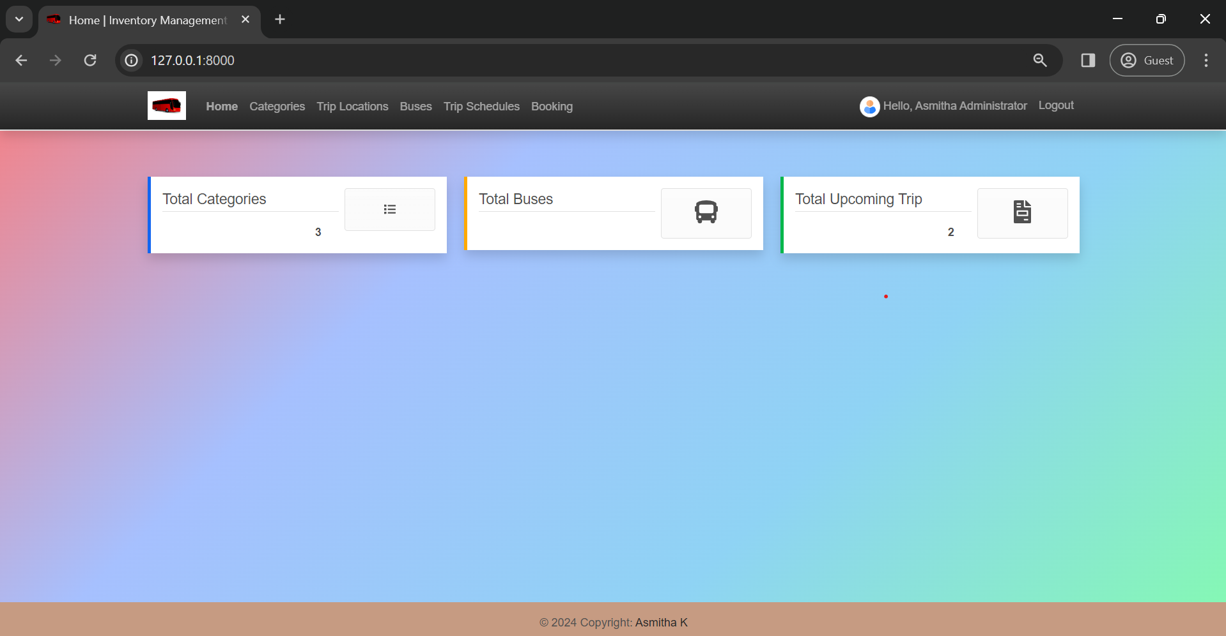
Homepage

Slide 11
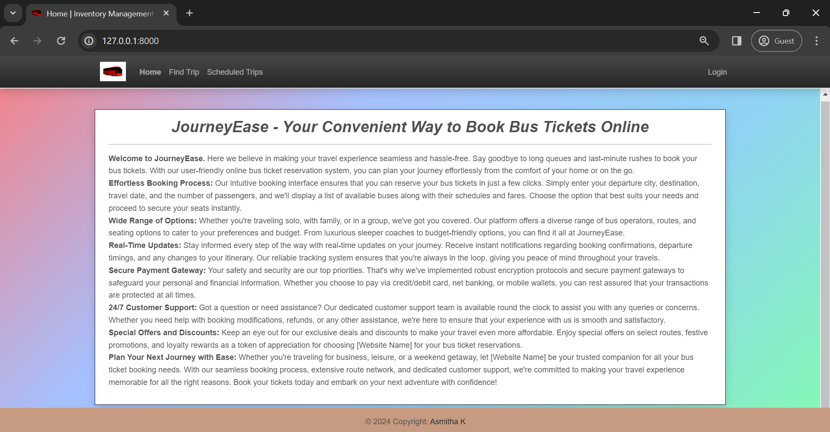
About-Us-Page

Slide 12
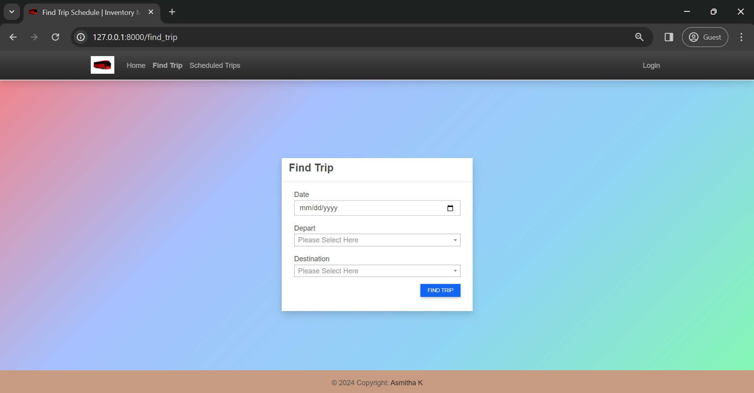
Service-Page

Slide 13
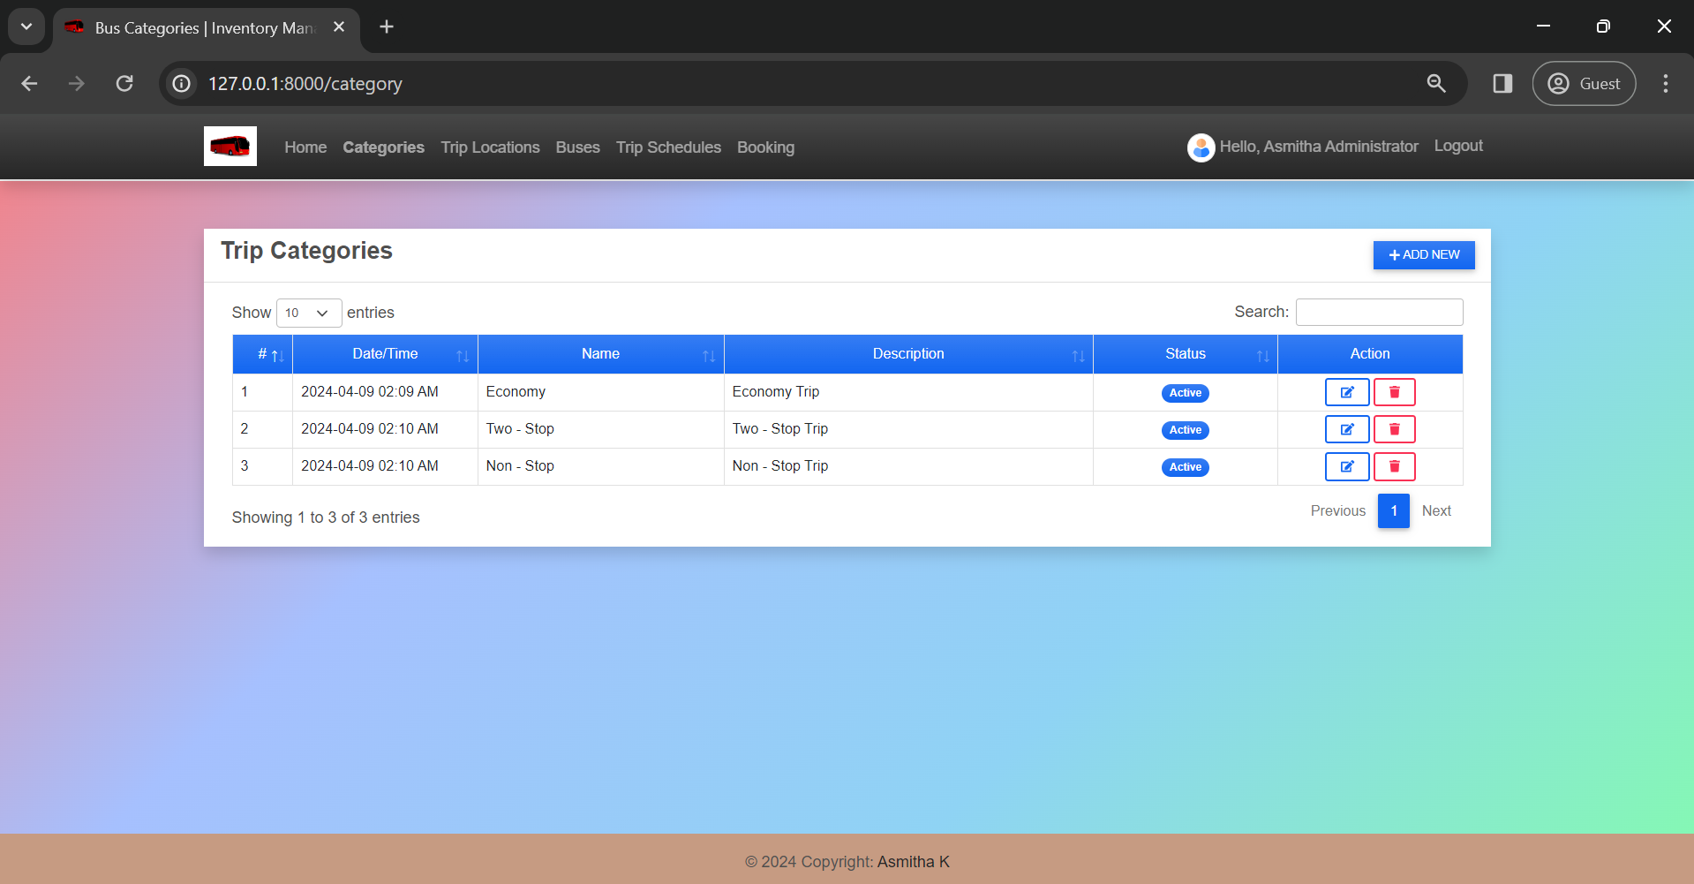
Departments-Page

Slide 14
Blog-Page

Slide 15
Future Enhancements:
Mobile Application: Develop a mobile app version of the bus ticket reservation system for increased accessibility and convenience for users on the go.
Route Optimization: Implement algorithms for route optimization to suggest the most efficient bus routes based on factors like distance, traffic conditions, and passenger demand.
Personalized Recommendations: Utilize machine learning algorithms to provide personalized recommendations for users based on their past booking history, preferences, and travel patterns.
Multi-language Support: Incorporate multi-language support to cater to a diverse user base and enhance accessibility for users from different regions.
Social Media Integration: Allow users to share their travel plans, bookings, and experiences on social media platforms, enhancing user engagement and marketing efforts.
Real-time Tracking: Integrate real-time bus tracking functionality to allow users to track the location and estimated arrival time of their booked buses.

Slide 16
Conclusion
In conclusion, the development of the online bus ticket reservation system using Python and Django, named "JourneyEase," has provided a comprehensive solution to streamline the bus booking process for both travelers and bus operators. Through the implementation of various features and functionalities, the system has addressed the challenges of traditional ticket booking methods and significantly improved the overall user experience.
The system offers a user-friendly interface for easy navigation, real-time bus route information, flexible booking options, and secure payment processing. Users can conveniently search for bus routes, select preferred departure times, choose seat preferences, and make secure online payments, all from the comfort of their own devices.
For bus operators, the system provides efficient management tools for scheduling, seat allocation, and monitoring bookings through the admin panel. The integration with payment gateways ensures smooth transaction processing, while the seat management system prevents overbooking and optimizes resource utilization.
Overall, the "JourneyEase" project represents a significant advancement in the realm of online transportation services, offering convenience, accessibility, and reliability to users while improving operational efficiency for bus operators. It has the potential to revolutionize the way bus tickets are booked and contribute to a more seamless and enjoyable travel experience for all.
Source : Python and Django Documentation

Slide 17
Thank You!
Notes:
Thank You !!

